Slide 1

Phonics Workshop
6th October
2022

Slide 2

Phonics Workshop
*What is phonics?
*How is Phonics taught?
*How do I help my child to read and blend words?
*How does Phonics help children to read?

Slide 3
In school, we follow the scheme Essential letters and sounds.
This is taught in EYFS and Year 1 through whole class lessons.
Year 2 and KS2 are taught as small groups and through Spelling lessons.

Slide 4

What is phonics?
It is a way of teaching reading where children are taught to read letters or groups of letters by saying the sound they represent.

Slide 5

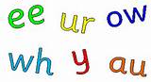
Cracking the Code
26 letters of the alphabet
44 sounds in the English Language
144 different ways we put letters together to represent the sounds
Notes:
Regular words / 20% irregular

Slide 6
Key Terms
Phoneme - sounds that make up words.
Graphemes – the letters that represent sounds.
Segmenting and blending
Digraph – a sound made up of two letters e.g. SH.
Trigraph – a sound made up of three letters e.g. IGH.
Split digraph – a sound made up of split letters e.g. make.
Adjacent Consonants – groups of consonants that keep their individual sounds but often appear together.
Abbreviations CVC, CCVC, VC words

Slide 7
Phase 1 – Skill Development
What Phases will be taught?
A1 – Environmental
A2 – Instrumental sounds
A3 – Body Percussion
A4 – Rhythm and rhyme
A5 – Alliteration
A6 – Voice sounds
A7 – Oral blending and segmenting.

Slide 8
Phase 2 – First Letters
Set 1: s, a, t, p
Set 2: i, n, m, d
Set 3: g, o, c, k
Set 4: ck, e, u, r
Set 5: h, b, f, ff, l, ll, ss

Slide 9
Phase 3 - Expansion
Set 6: j, v, w, x
Set 7: y, z, zz, qu
Consonant digraphs: ch, sh, th, ng
Digraphs and trigraphs: ai, ee, igh, oa, oo, ar, or, ur, ow, oi, ear, air, ure, er

Slide 10
Phase 4 - Consolidation
This phase consolidates all the children have learnt in the previous phases.
Includes adjacent consonants
e.g. Pl ay

Slide 11
Phase 5
Children will be taught new graphemes and alternative pronunciations for these graphemes.
Digraphs: wh, ph, ay, ou, ie, ea, oy, ir, ue, aw, ew, oe, au
Split digraphs: a_e, e_e, i_e, o_e, u_e

Slide 12
Phase 6
The focus is on learning spelling rules for suffixes.
-s -es -ing -ed
-er -est -y -en
-ful -ly -ment -ness

Slide 13

https://vimeo.com/753931102/b9a2f8194f

Slide 14


Slide 15
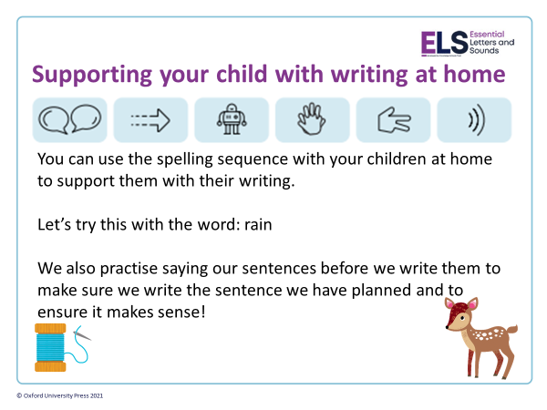

Slide 16
Segmenting
Breaking down words for spelling.
cat
c a t
* Robot arms

Slide 17
Segmenting
Queen
qu ee n

Slide 18
Blending
Building words from phonemes to read.
c a t
cat

Slide 19
Blending
Qu ee n
queen

Slide 20
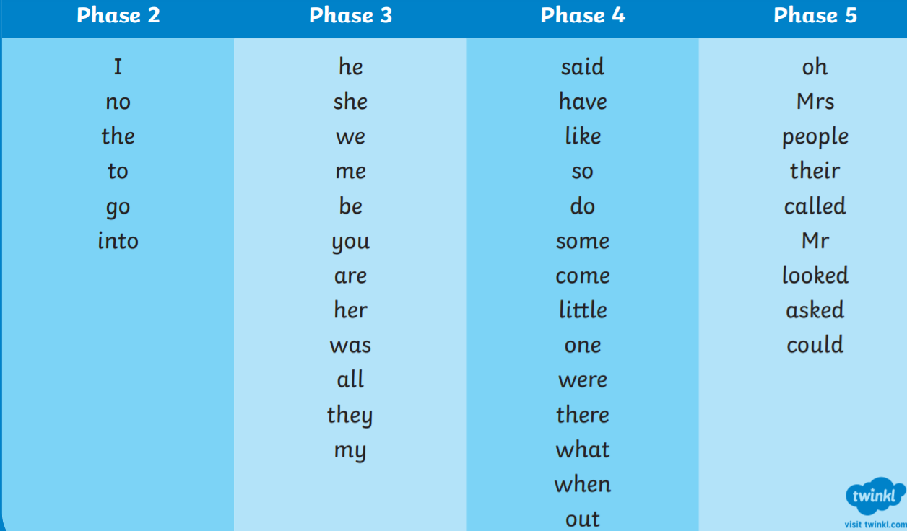
Harder to Read Words

Slide 21
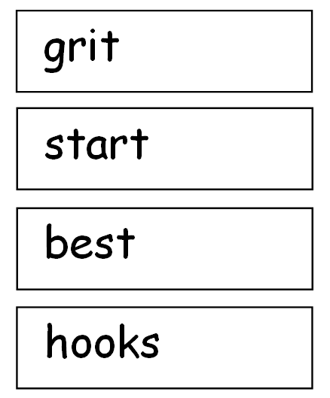
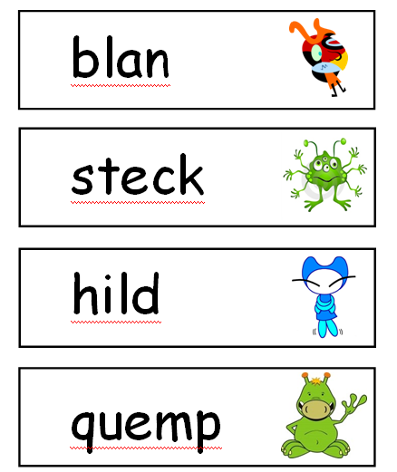
Year 1 Phonics Test

Slide 22
Reading
For homework:
1. We give one book based on the phonics we have covered in school.
2. A second book based on their Phonic ability.
3. A pleasure for reading book. For you to read together.
As well as being able to read fluently children need to be able to talk about what they have read.
*Remember when you are supporting your child to read you must use the letter sounds.
*You may find that the children can read the book fluently but we also look for their understanding about what they have read. There are usually questions at the back of the books for support.
*They should read the book more than once to help their comprehension.
*Please help your child read 4x a week and write in their Monkey books to enable them to move up the reading rainbow. At the end of the term there will be a prize given to those who have reached the top.
*Don’t just read schoolbooks read anything that engages your child in reading to promote a love of reading- magazines, comics, nonfiction etc.

Slide 23
What can you do to support your child?
Spellings
Ensuring children are using the phonemes when sounding out words in their reading books
Here are some ideas and links to help with learning phonics:
-See if you can spot sounds/tricky words around house or town etc.
- Sound Eye Spy
https://www.phonicsbloom.com/
https://www.phonicsplay.co.uk/
www.teachyourmonstertoread.com
How to pronounce each letter sound:
https://vimeo.com/753929025/5eaa45c0aa - Phase 2
https://vimeo.com/753931102/b9a2f8194f - Phase 3
https://vimeo.com/753933192/43104a30e0 - Phase 5

Slide 24

Any Questions?

